Slide 1


= interview
= questionnaire
kids/pets
none
multiple
4
3
6
9
10
5
2
8
1
7
Confidence in ability to utilize smart home devices
not confident
confident
9
7
6
5
8
1
2
4
3
10
Technological skills [5 being good and 1 being bad]
Bad (1)
9
Good (5)
7
6
5
8
1
10
2
4
3
Number of smart device owned
none
multiple
9
6
5
7
4
3
2
10
8
1
Neighbourhood safety
Not safe
Very safe
1
8
5
6
7
3
10
4
2
9
Notes:
The colours 'red' 'blue' and 'green' show the similarities in participants across interviews and questionnaires. [participant 9 is opposite to numbers 1 and 8]

Slide 2
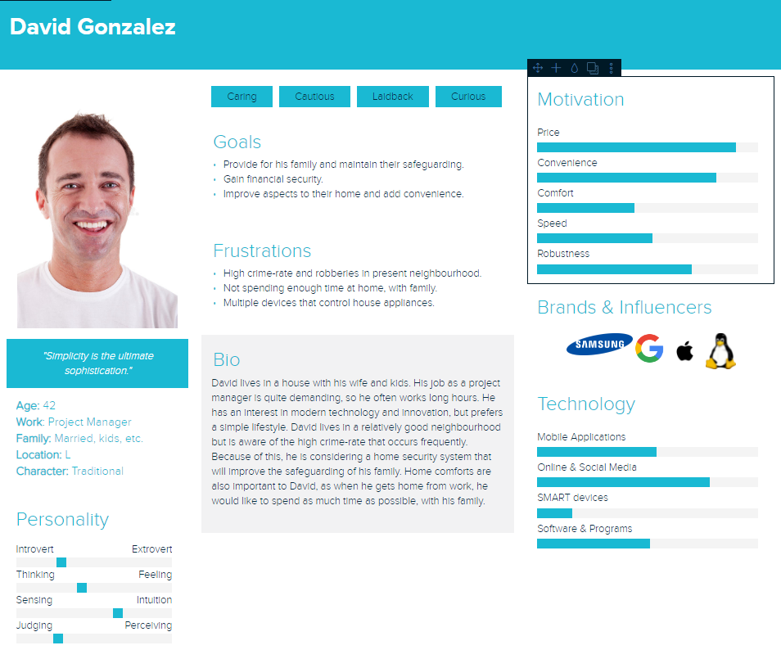

Slide 3
